Slide 1

Agile vs Waterfall
June 2013
This document is confidential and contains proprietary information, including trade secrets of CitiusTech. Neither the document nor any of the information contained in it may be reproduced or disclosed to any unauthorized person under any circumstances without the express written permission of CitiusTech.

Slide 2
Background
Waterfall definition
Agile Definition
Objectives
Difference between Agile and Waterfall
Waterfall Challenges
Waterfall approach
Agile approach
When to use the methodologies

Slide 3
Waterfall Definition
Waterfall methodology is a sequential design process.
This means that as each of the eight stages (conception, initiation, analysis, design, construction, testing, implementation, and maintenance) are completed, the developers move on to the next step.
As this process is sequential, once a step has been completed, developers can’t go back to a previous step – not without scratching the whole project and starting from the beginning. There’s no room for change or error, so a project outcome and an extensive plan must be set in the beginning and then followed carefully.

Slide 4
Agile definition
Agile methodology follows an incremental approach
Developers start off with a simplistic project design, and then begin to work on small modules.
The work on these modules is done in weekly or monthly sprints, and at the end of each sprint, project priorities are evaluated and tests are run.
These sprints allow for bugs to be discovered, and customer feedback to be incorporated into the design before the next sprint is run

Slide 5
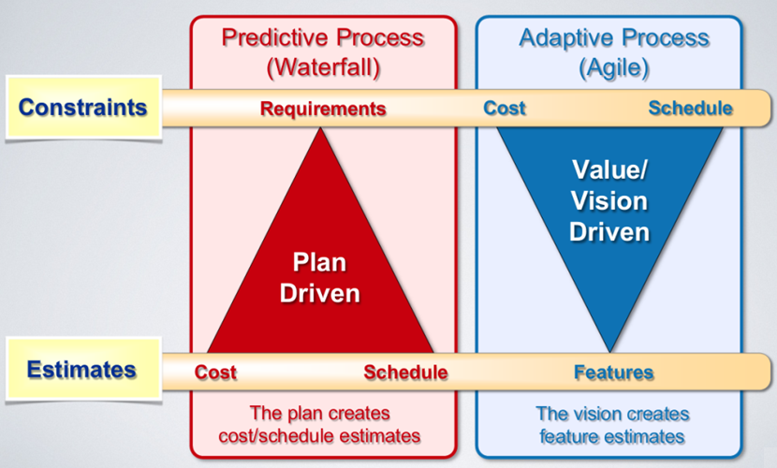
Agile vs Waterfall (1/2)
Agile
Agile is a value-driven model
Focuses on actually delivering the top priority features
Stay within cost and on schedule
Waterfall
Waterfall is a plan-driven model
Involves estimating each features and creating a plan/schedule based on those estimates
In case of any slip, project cost or schedule will be affected

Slide 6
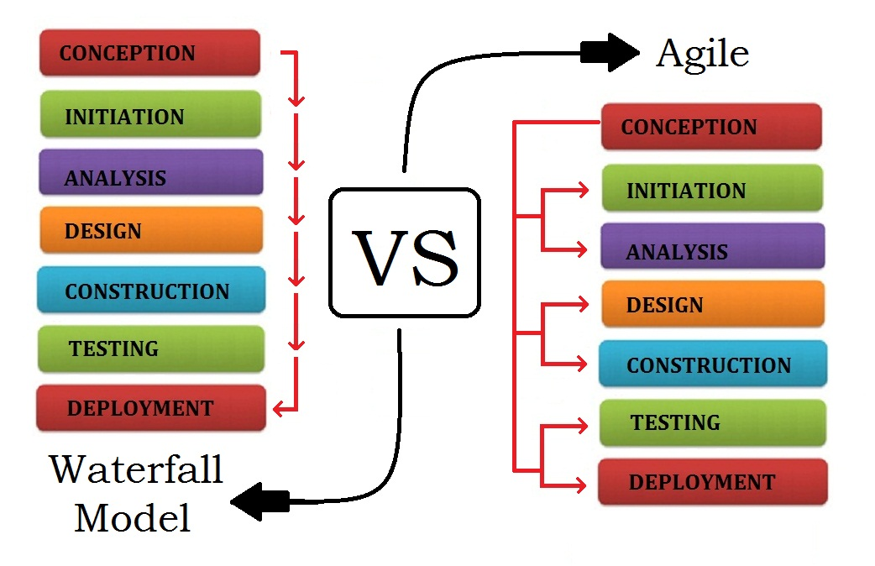
Agile vs Waterfall (2/2)

Slide 7
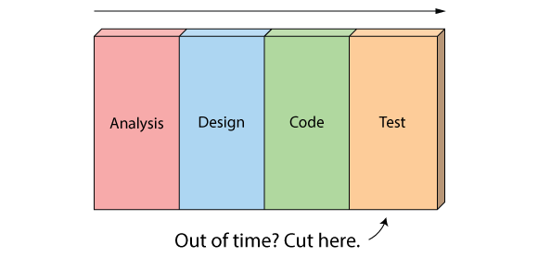
Waterfall challenges
Traditional Waterfall treats analysis, design, coding, and testing as discrete phases in a software project. This worked OK when the cost of change was high. But now that it's low it hurts us in a couple of ways.
Poor quality
When the project starts to run out of time and money, testing is the only phase left. This means good projects are forced to cut testing short and quality suffers.

Slide 8
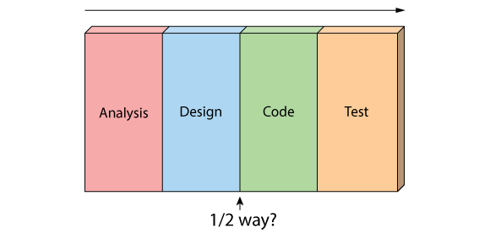
Waterfall challenges
Poor visibility
As working software isn't produced until the end of the project, you never really know where you are on a Waterfall project
Last 20% of the project always seems to take 80% of the time

Slide 9
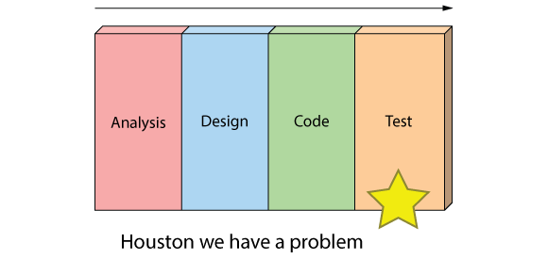
Waterfall challenges
Too risky
Schedule risk – You never know if you are going to make it until the end.
Technical risk – You don't actually get to test your design or architecture until late in the project.
Product risk – You don't know if you are building the right product until it's too late to make any changes.

Slide 10
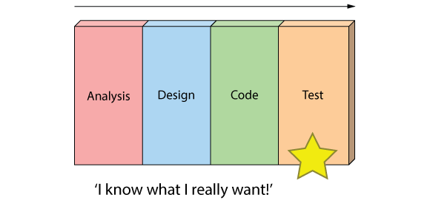
Waterfall challenges
Change Management - It's just not a great way for handling change
Can't handle change

Slide 11
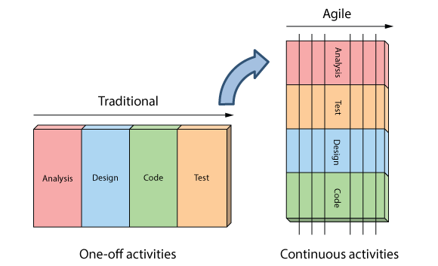
The Agile Approach
Instead of treating these fixed stages Agilists believe that these are continuous activities
By doing them continuously:
Quality improves because testing starts from day one
Visibility improves because you are 1/2 way through the project when you have built 1/2 the features
Risk is reduced because you are getting feedback early, and
Customers are happy because they can make changes without paying exorbitant costs

Slide 12
Waterfall Approach
QA
Requirements System Feasibility, Software plans
Requirements V & V
Requirement reviews
Design (System and Software)
Design V & V Model Checking, Check Lists
Implementation Unit Testing
Development Inspection, Reviews
Integration System Testing
Development Integration and Acceptance Testing
Maintenance
Tools

Slide 13
Agile Approach
QA
Requirement Definition & Design
Requirement & Design QA System Metaphor On-site customer
Release planning stories, Functional Test Cases
Implementation and Unit Testing Iteration planning Development Test Case Creation
Development QA Refactoring Pair Programming Daily Stand Up Meetings
Integration and System testing
Continuous Integration
Acceptance Testing
Small Releases
Development QA Onsite Customer Satisfaction

Slide 14
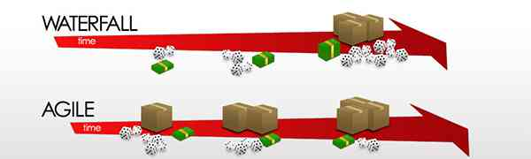
Agile vs Waterfall

Slide 15
When to use the waterfall model
This model is used only when the requirements are very well known, clear and fixed
Product definition is stable
Technology is understood
There are no ambiguous requirements
Ample resources with required expertise are available freely
The project is short

Slide 16
When to use the Agile model
When rapid production is more important than the quality of the product.
When clients will be able to chance the scope of the project.
When there isn’t a clear picture of what the final product should look like.
When you have skilled developers who are adaptable and able to think independently.
When the product is intended for an industry with rapidly changing standards.

